Slide 1
Cloud Computing
5th Dec
Unit 2

Slide 2
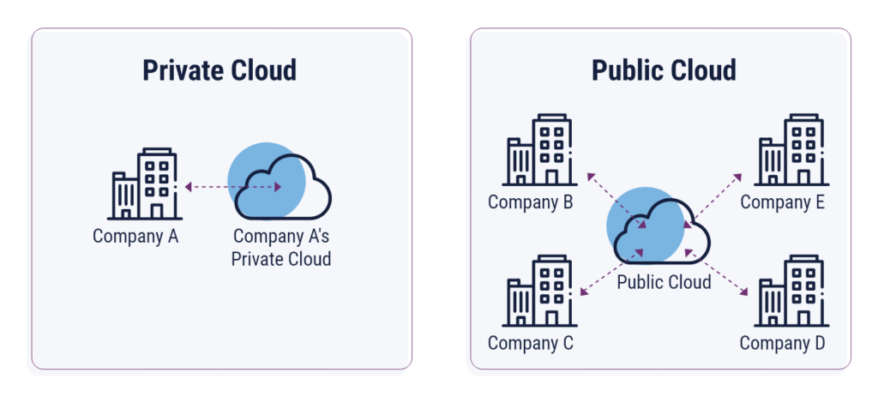
Private/Public Cloud

Slide 3
Hybrid Cloud
Optimize Workload Distribution: Sensitive workloads can remain in the private cloud, while less critical or scalable tasks can utilize the hybrid cloud's flexibility.
Enhance Scalability: During peak usage, the hybrid cloud can handle overflow traffic, ensuring uninterrupted operations.
Improve Cost Efficiency: Organizations can balance costs by using the public cloud for non-sensitive tasks while maintaining critical operations in the private cloud.

Slide 4
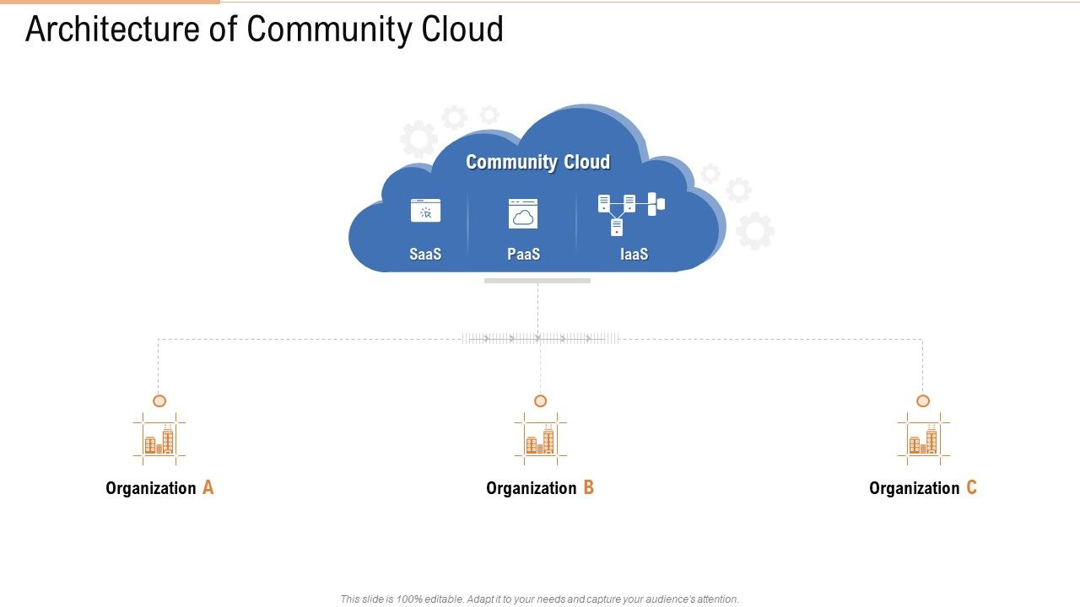
Community Cloud

Slide 5
Resilience in Cloud Computing
Resilience refers to a system’s ability to keep working even when something goes wrong—such as a server failure, network issue, or hardware problem.
Example:
If one server crashes, another automatically takes over, and users don’t experience downtime.
In short:
➡️ Keeps services available
➡️ Recovers quickly from failures
➡️ Prevents downtime

